Slide 1

Bootstrap
The most popular front-end component library
SoftUni Team
Technical Trainers
Software University
https://softuni.bg

Slide 2
Table of Contents
Introduction to Bootstrap
How to Import Bootstrap?
Bootstrap Grid System
Styling Components

Slide 3
Have a Question?
sli.do #js-front-end

Slide 4

Bootstrap
Build responsive, mobile-first projects

Slide 5

What is a Responsive Design?
Presentation layers that adjust according to the screen size of the different devices
Desktop layouts
Tablet layouts
Mobile layouts

Slide 6

Bootstrap
World's most popular front-end component library
Open source toolkit for developing with HTML, CSS, and JS
Works with
Responsive grid system
Extensive prebuilt components
Powerful plugins built on jQuery

Slide 7

How to Import Bootstrap?
Import Options

Slide 8
Include from a BootstrapCDN - CSS
Sometimes you need to include only a specific module
You can do that, using BootstrapCDN
Include Bootstrap's compiled and minified CSS
Only CSS
<link rel="stylesheet" href="https://stackpath.bootstrapcdn.com/bootstrap/4.4.1/css/bootstrap.min.css">

Slide 9
Include from a BootstrapCDN - JS
Be sure to place jQuery and Popper first, as the Bootstrap code depends on them
JavaScript, Popper.js and jQuery
<script src="https://code.jquery.com/jquery-3.4.1.slim.min.js"></script>
<script src="https://cdn.jsdelivr.net/npm/popper.js@1.16.0/dist/umd/popper.min.js"></script>
<script src="https://stackpath.bootstrapcdn.com/bootstrap/4.4.1/js/bootstrap.min.js">
</script>

Slide 10
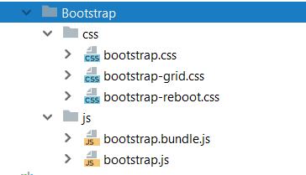
Download Resources
Compiled and minified CSS and JavaScript. No docs or original source files are included.
<link rel="stylesheet" href="../bootstrap/css/bootstrap.min.css"/>
<script src="../jquery/jquery.3.4.1.min.js"></script>
<script src="../bootstrap/js/bootstrap.min.js"></script>

Slide 11
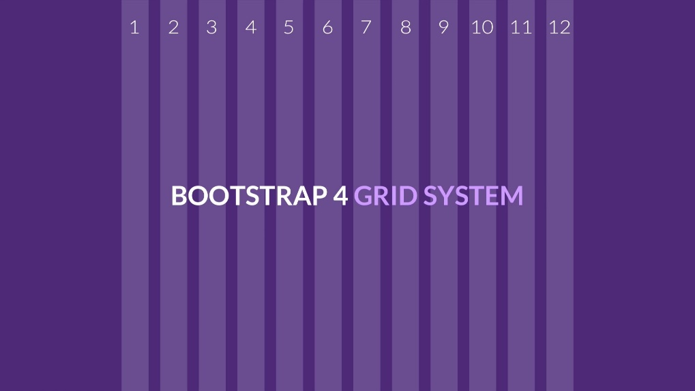
Bootstrap Grid System
Build layouts with grid - twelve column system

Slide 12

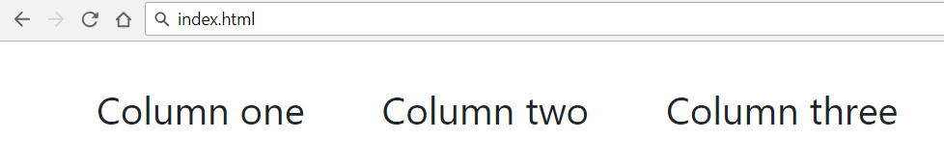
Bootstrap Grid System Demo
<!-- . . . -->
<div class="container">
<div class="row">
<div class="col-xs m-3">Column one</div>
<div class="col-xs m-3">Column two</div>
<div class="col-xs m-3">Column three</div>
</div>
</div>
<!-- . . . -->

Slide 13
Bootstrap Containers
Rows must be placed in containers
.container has one fixed width for each screen size in bootstrap (xs, sm, md, lg)
.container-fluid expands to fill the available width
Responsive pixel width
width: 100%

Slide 14
Column Classes
Determines how many columns to use on different screen sizes
.col-xs: width less than 768px
.col-sm: width between 768px and 992px
.col-md: width between 992px and 1200px
.col-lg: width over 1200px
<div class="col-sm-8 col-lg-4">Column one</div>
<div class="col-sm-2 col-lg-4">Column two</div>
<div class="col-sm-2 col-lg-4">Column three</div>

Slide 15
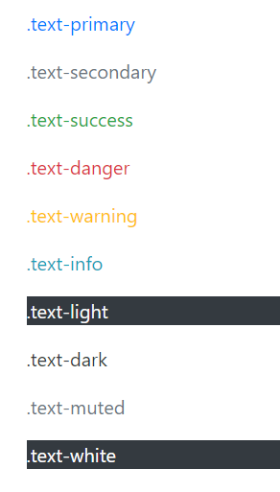
Color
Handful of color utility classes
<p class="text-primary">.text-primary</p>
<p class="text-secondary">.text-secondary</p>
<p class="text-success">.text-success</p>
<p class="text-danger">.text-danger</p>
<p class="text-warning">.text-warning</p>
<p class="text-info">.text-info</p>
<p class="text-light bg-dark">.text-light</p>
<p class="text-dark">.text-dark</p>
<p class="text-muted">.text-muted</p>
<p class="text-white bg-dark">.text-white</p>

Slide 16
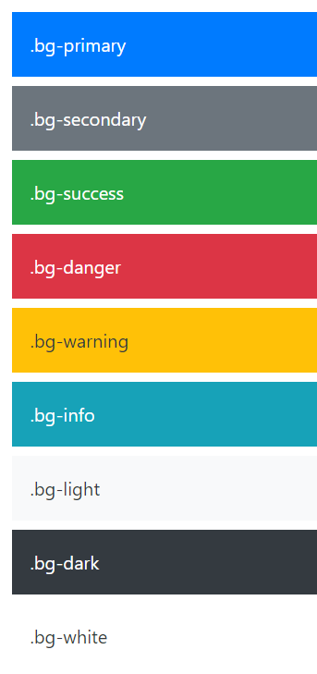
Background Color
Easily set the background of an element to any contextual class
<div class="bg-primary text-white">.bg-primary</div>
<div class="bg-secondary text-white">.bg-secondary</div>
<div class="bg-success text-white">.bg-success</div>
<div class="bg-danger text-white">.bg-danger</div>
<div class="bg-warning text-dark">.bg-warning</div>
<div class="bg-info text-white">.bg-info</div>
<div class="bg-light text-dark">.bg-light</div>
<div class="bg-dark text-white">.bg-dark</div>
<div class="bg-white text-dark">.bg-white</div>

Slide 17
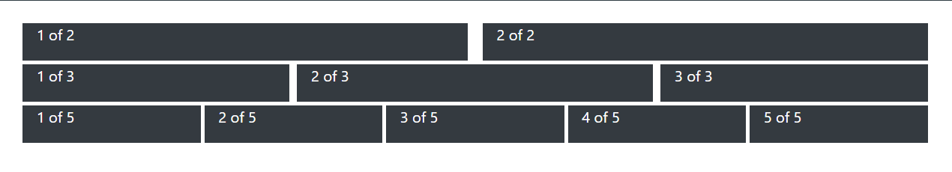
Problem: Grid System
Create a page like the following, using Bootstrap Grid System
Use class row for every line
Define containers with class col inside every row

Slide 18

Theming Bootstrap
Enable the built-in theme to add components

Slide 19
Bootswatch
Bootswatch is a collection of open source themes for Bootstrap
Usage
Download the bootstrap.min.css file
Replace Bootstrap's default stylesheet
Still include Bootstrap's JavaScript file to have functional dropdowns, modals, etc.

Slide 20

Bootstrap Components
Over a dozen reusable components

Slide 21
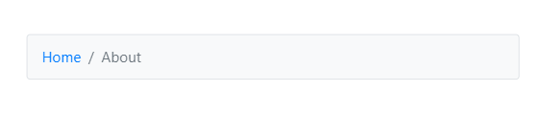
Page Header and Breadcrumbs
Indicate the current page’s location within a navigational hierarchy
<nav aria-label="breadcrumb">
<ol class="breadcrumb bg-light container m-5 border">
<li class="breadcrumb-item"><a href="#">Home</a></li>
<li class="breadcrumb-item active" aria-current="page">About</li>
</ol>
</nav>

Slide 22
Button Groups
Custom button styles with support for multiple sizes, states, and more
<button type="button" class="btn btn-primary">Primary</button>
<button type="button" class="btn btn-secondary">Secondary</button>
<button type="button" class="btn btn-success">Success</button>
<button type="button" class="btn btn-danger">Danger</button>

Slide 23
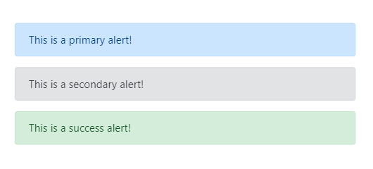
Alerts
Provide contextual feedback messages for typical user actions with the handful of flexible alert messages
<div class="container m-5">
<div class="alert alert-primary" role="alert">
This is a primary alert! </div>
<div class="alert alert-secondary" role="alert">
This is a secondary alert! </div>
<div class="alert alert-success" role="alert">
This is a success alert! </div>
</div>

Slide 24
Nav and Navbar
Require a wrapping .navbar
Responsive by default
Come with built-in support for a handful of sub-components
.navbar-brand for your company, product, or project name
.navbar-nav for a full-height and lightweight navigation
.nav-item for every item in navigation

Slide 25

Nav and Navbar with Bootstrap
<nav class="navbar navbar-expand-lg navbar-light bg-light">
<a class="navbar-brand" href="#">Navbar</a>
<button class="navbar-toggler“ type="button" data-toggle="collapse" data-target="#navbarNav" aria-controls="navbarNav" aria-expanded="false" aria-label="Toggle navigation"><span class="navbar-toggler-icon"></span>
</button>
<div class="collapse navbar-collapse" id="navbarNav">
<ul class="navbar-nav">
<li class="nav-item active">
<a class="nav-link" href="#">Home <span class="sr-only">(current)</span></a>
</li>
<li class="nav-item"><a class="nav-link" href="#">Features</a></li>
</ul>
</div>
</nav>

Slide 26
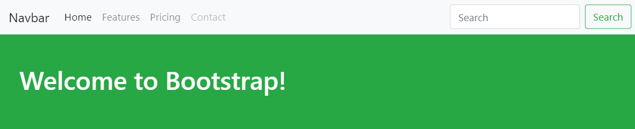
Problem: Navigation Bar
Create the following navigation bar using Bootstrap
Take a look at documentation and examples for Bootstrap's powerful, responsive navbar

Slide 27
Solution: Navigation Bar
nav class="navbar navbar-expand-lg navbar-light bg-light">
<a class="navbar-brand" href="#">Navbar</a>
<button class="navbar-toggler" type="button“ data-toggle="collapse" data-target="#navbarSupportedContent" aria-controls="navbarSupportedContent"
aria-expanded="false" aria-label="Toggle navigation">
<span class="navbar-toggler-icon"></span>
</button> <div class="collapse navbar-collapse" id="navbarSupportedContent">
<ul class="navbar-nav mr-auto">
<li class="nav-item active">
<a class="nav-link" href="#">Home <span class="sr-only">(current)</span></a>
</li>
<!-- TODO: Add the other list items -->
</ul>
<!-- . . . -->

Slide 28
Solution: Navigation Bar (2)
<!-- . . . -->
<form class="form-inline my-2 my-lg-0">
<input class="form-control mr-sm-2" type="search" placeholder="Search" aria-label="Search"/>
<button class="btn btn-outline-success my-2 my-sm-0" type="submit">
Search
</button>
</form>
</div>
</nav>

Slide 29
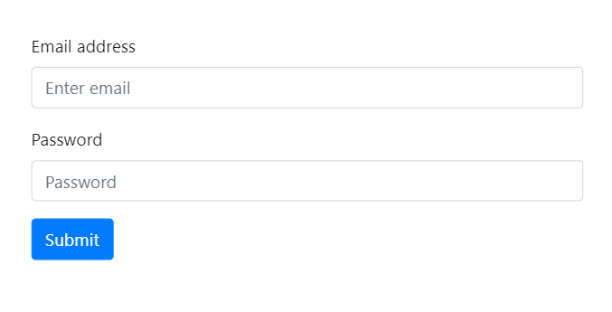
Forms
<form class="container m-5">
<div class="form-group">
<label for="exampleInputEmail1">Email address</label>
<input type="email" class="form control" id="exampleInputEmail1" placeholder="Enter email"></div>
<div class="form-group">
<label for="exampleInputPassword1">Password</label>
<input type="password" class="form-control" id="exampleInputPassword1" placeholder="Password"></div>
<button type="submit" class="btn btn-primary">Submit</button>
</form>

Slide 30
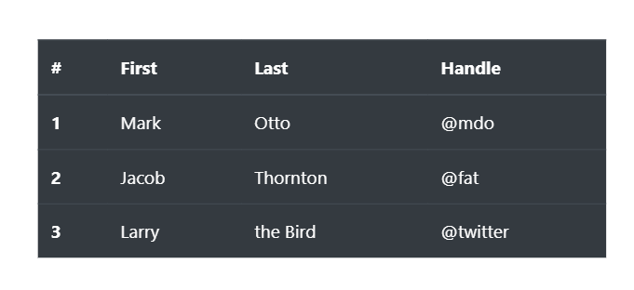
Tables
<div class="container m-5">
<table class="table table-dark">
<thead>
<tr>
<th scope="col">#</th>
<th scope="col">First</th>
<th scope="col">Last</th>
<th scope="col">Handle</th>
</tr>
</thead>
<tbody>
<tr> <th scope="row">1</th>
<td>Mark</td>
<td>Otto</td>
<td>@mdo</td> </tr>
<!-- TODO: Add the other rows -->
</tbody>
</table>
</div>

Slide 31
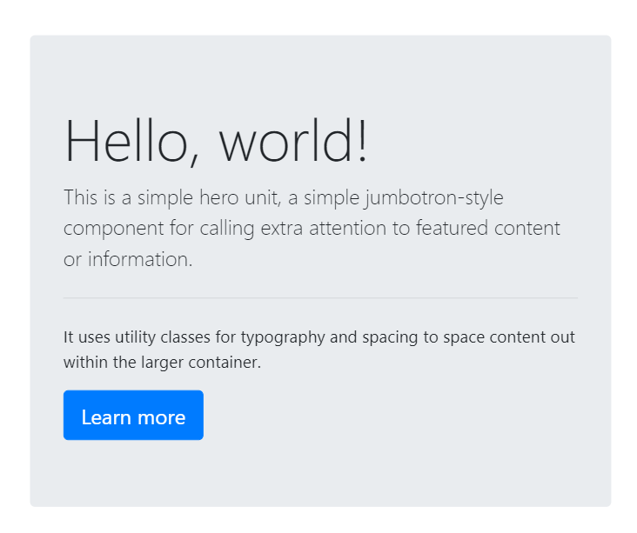
Jumbotron
Lightweight, flexible component for showcasing hero unit style content
<div class="jumbotron ">
<h1 class="display-4">Hello, world!</h1>
<p class="lead">...</p>
<hr class="my-4">
<p>...</p>
<a class="btn btn-primary btn-lg" href="#" role="button">Learn more</a>
</div>

Slide 32

Live Exercises

Slide 33

Summary
…
…
…
Bootstrap - the most popular HTML,
CSS and JS framework
Responsive, mobile-first, prevailing
Easy to use and to learn it
Free and open source
Simple Integration
12-column responsive grid
Cheatsheet to Bootstrap components

Slide 34
Questions?
Notes:
34

Slide 35












SoftUni Diamond Partners

Slide 36




SoftUni Organizational Partners

Slide 37
Trainings @ Software University (SoftUni)
Software University - High-Quality Education, Profession and Job for Software Developers
softuni.bg, softuni.org
Software University Foundation
softuni.foundation
Software University @ Facebook
facebook.com/SoftwareUniversity
Software University Forums
forum.softuni.bg
Notes:
37

Slide 38

License
This course (slides, examples, demos, exercises, homework, documents, videos and other assets) is copyrighted content
Unauthorized copy, reproduction or use is illegal
© SoftUni - https://softuni.org
© Software University - https://softuni.bg
Notes:
38

